Slide 1

DIGITAL LOGIC DESIGN (111776)
Dr. Owais Hussain

Slide 2

Agenda
Registers
Shift Registers
Bidirectional Shift Register
Universal Shift Register
Ring Counters
Johnson Counters

Slide 3
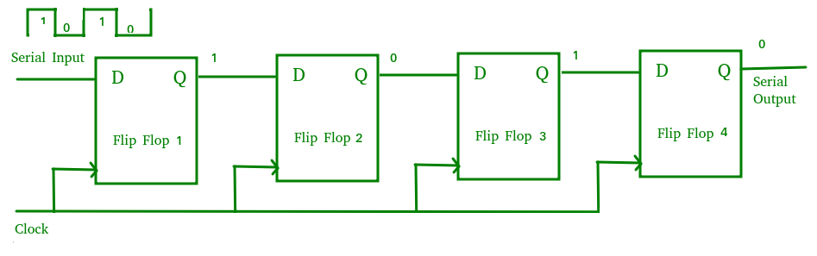
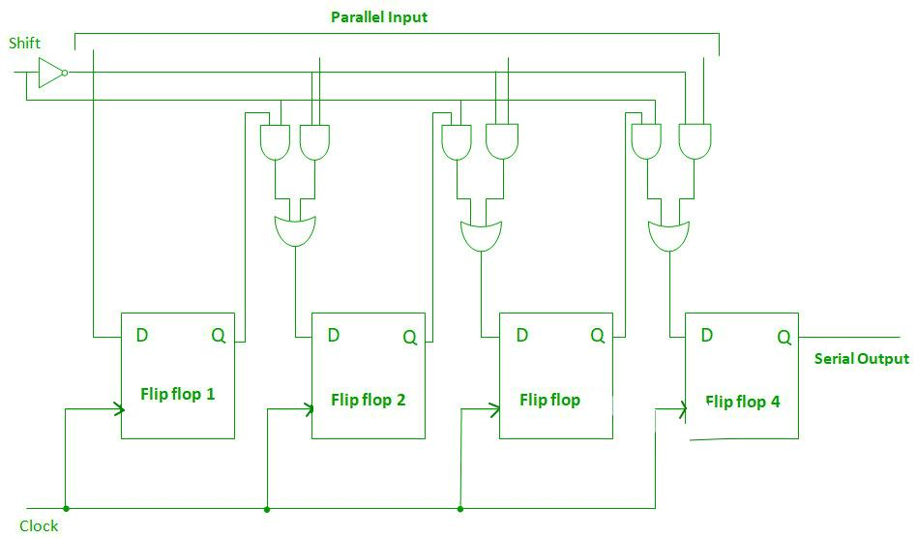
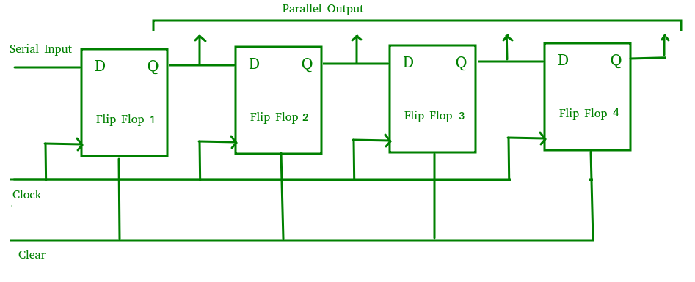
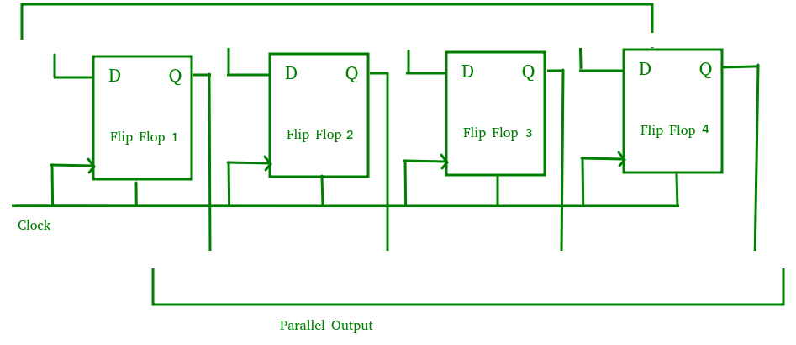
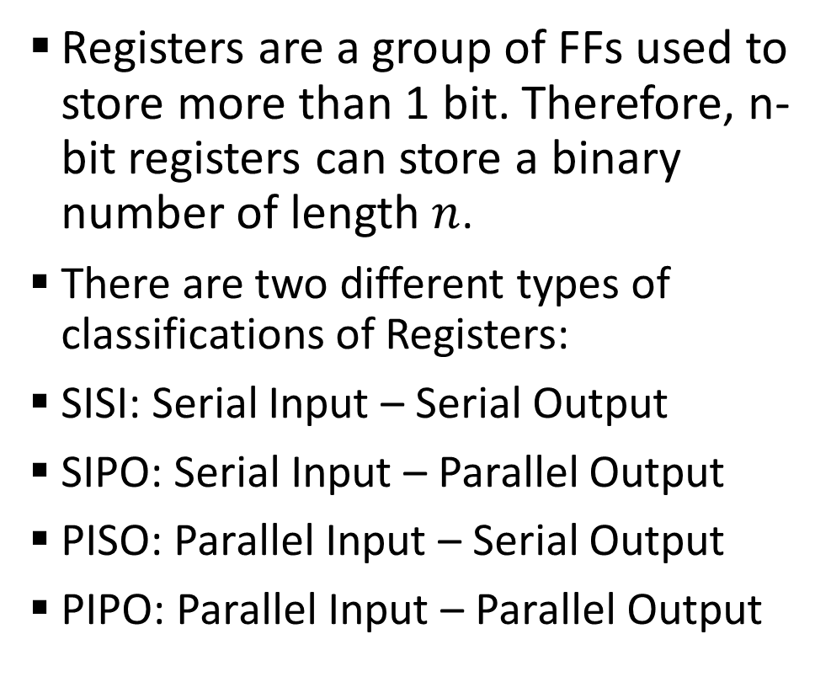
Sample 2
Registers
Registers are a group of FFs used to store more than 1 bit. Therefore, n-bit registers can store a binary number of length $n$.
There are two different types of classifications of Registers:
SISI: Serial Input – Serial Output
SIPO: Serial Input – Parallel Output
PISO: Parallel Input – Serial Output
PIPO: Parallel Input – Parallel Output

Slide 4
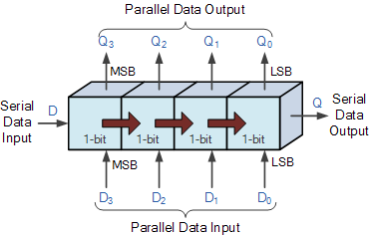
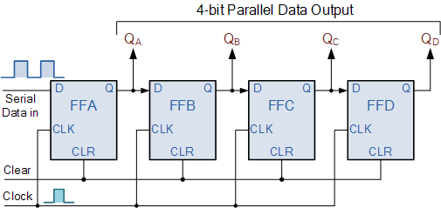
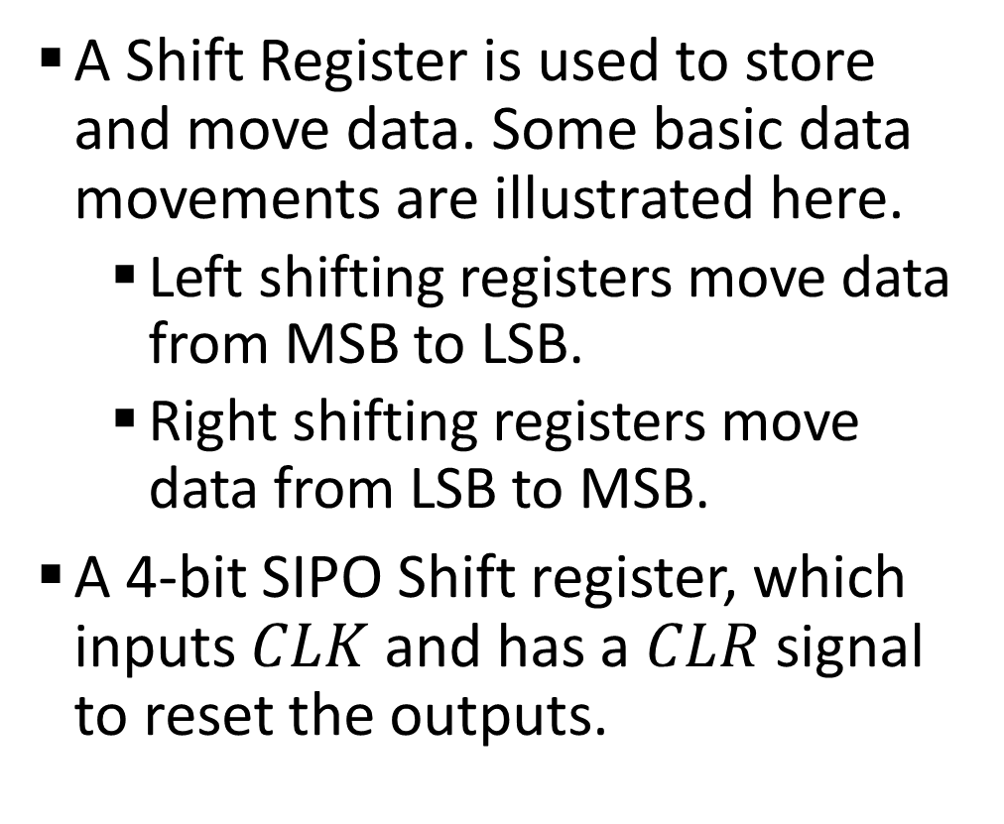
Sample 2
Shift Registers
A Shift Register is used to store and move data. Some basic data movements are illustrated here.
Left shifting registers move data from MSB to LSB.
Right shifting registers move data from LSB to MSB.
A 4-bit SIPO Shift register, which inputs $CLK$ and has a $CLR$ signal to reset the outputs.

Slide 5
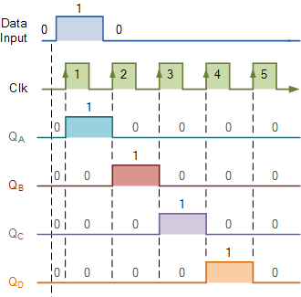

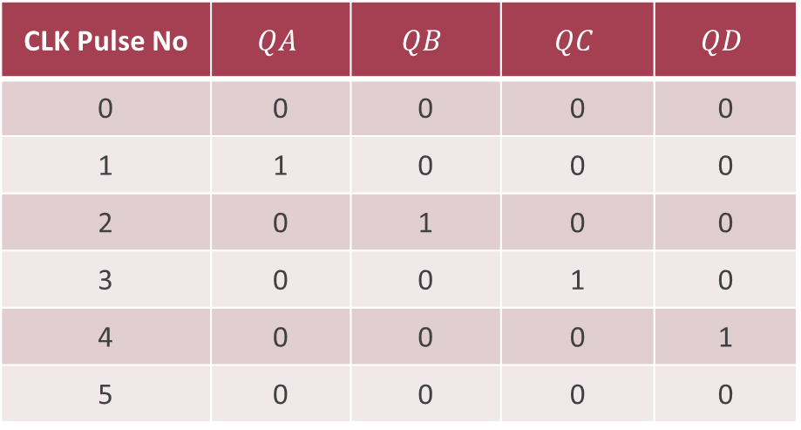
Sample 2
Shift Registers
Basic shifting through a Left shifting Register. After the 4th Pulse, the data 0001 will remain there provided that $CLK$ has stopped.
CLK Pulse No | $$QA$$ | $$QB$$ | $$QC$$ | $$QD$$
0 | 0 | 0 | 0 | 0
1 | 1 | 0 | 0 | 0
2 | 0 | 1 | 0 | 0
3 | 0 | 0 | 1 | 0
4 | 0 | 0 | 0 | 1
5 | 0 | 0 | 0 | 0

Slide 6
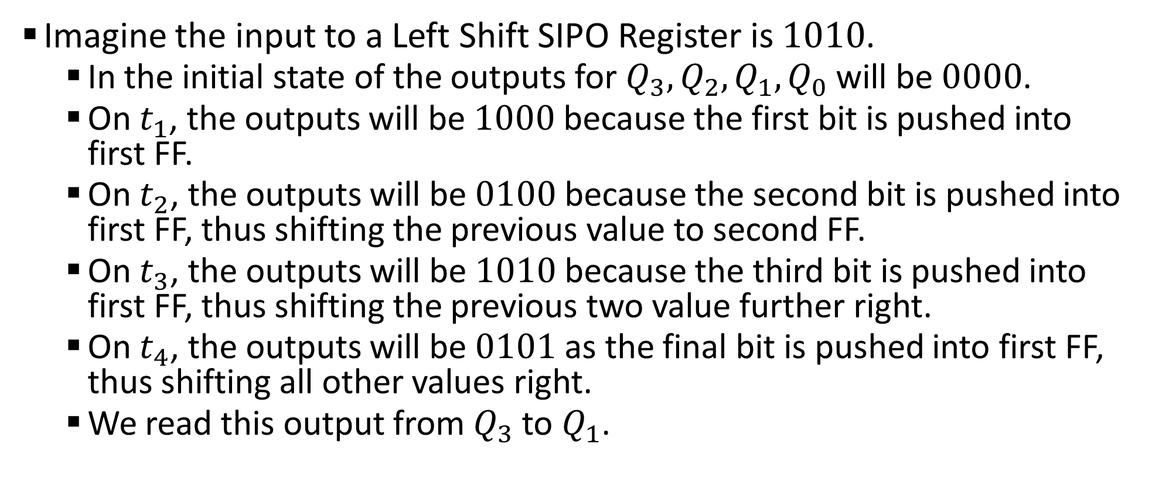
Sample 2
Shift Registers
Imagine the input to a Left Shift SIPO Register is $1010$.
In the initial state of the outputs for $Q_{3},Q_{2},Q_{1},Q_{0}$ will be $0000$.
On $t_{1}$, the outputs will be $1000$ because the first bit is pushed into first FF.
On $t_{2}$, the outputs will be $0100$ because the second bit is pushed into first FF, thus shifting the previous value to second FF.
On $t_{3}$, the outputs will be $1010$ because the third bit is pushed into first FF, thus shifting the previous two value further right.
On $t_{4}$, the outputs will be $0101$ as the final bit is pushed into first FF, thus shifting all other values right.
We read this output from $Q_{3}$ to $Q_{1}$.

Slide 7
Sample 2
Bidirectional Shift Register
Here is an example of Bidirectional Shift Register.
In this case, we have the Register in PISO mode. However, the Register can be in any other mode as well.

Slide 8
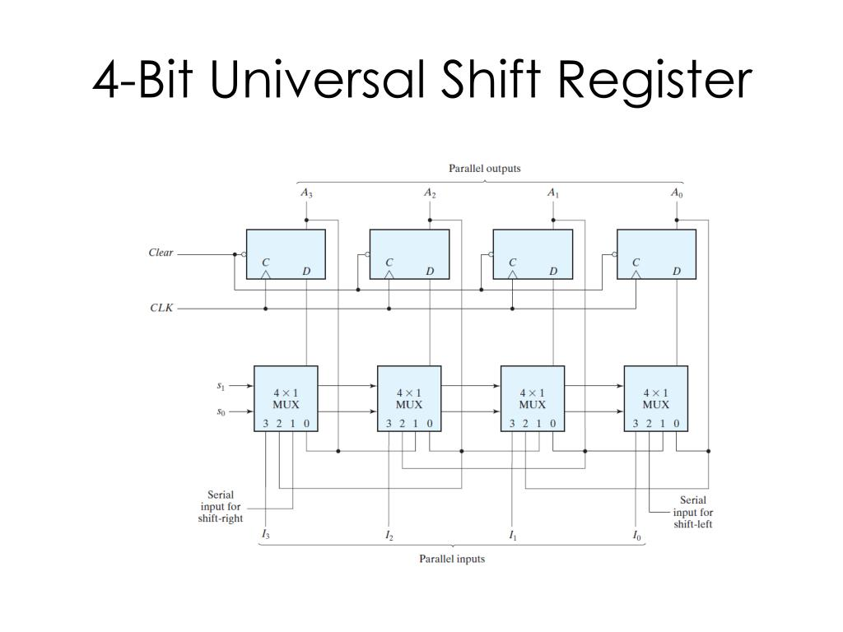
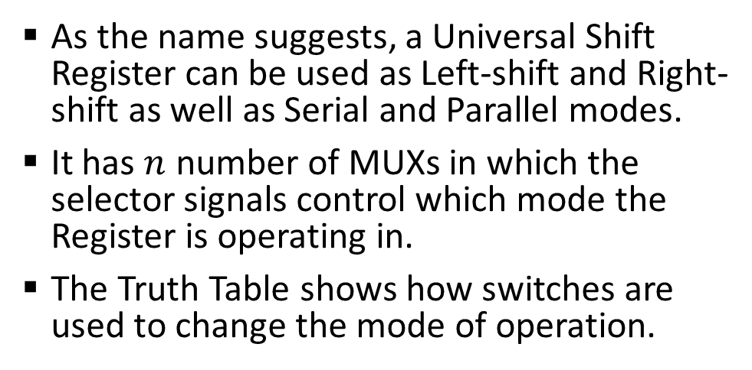
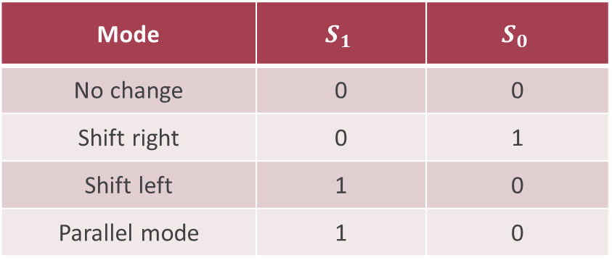
Sample 2
Universal Shift Register
As the name suggests, a Universal Shift Register can be used as Left-shift and Right-shift as well as Serial and Parallel modes.
It has $n$ number of MUXs in which the selector signals control which mode the Register is operating in.
The Truth Table shows how switches are used to change the mode of operation.
Mode | $$S_{1}$$ | $$S_{0}$$
No change | 0 | 0
Shift right | 0 | 1
Shift left | 1 | 0
Parallel mode | 1 | 0

Slide 9
Sample 2
Universal Shift Register
Shift registers have a variety of applications:
Used in micro-controllers for Input/Output expansion.
Used as converter from serial-parallel and parallel-serial.
Used to transfer data in serial-serial and parallel-parallel mode.
Used as a memory in computers.
Used in time delay applications.
Used as frequency counters, binary counters, and Digital clocks

Slide 10
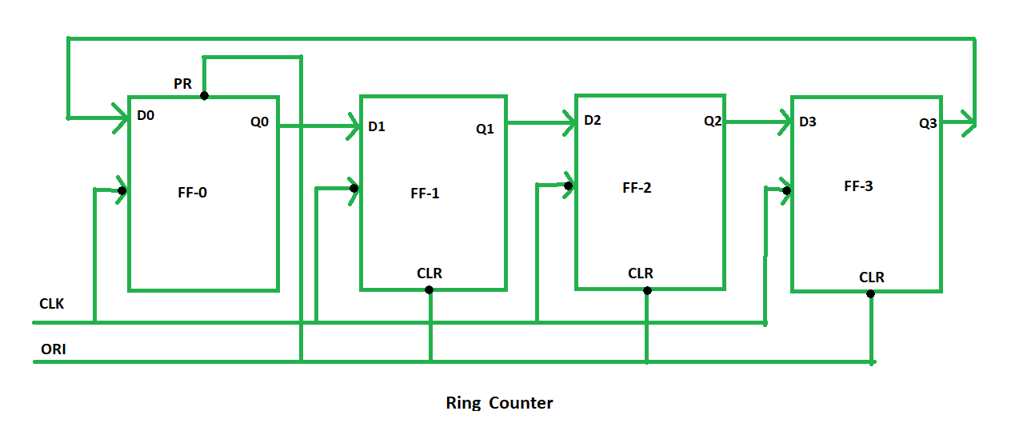
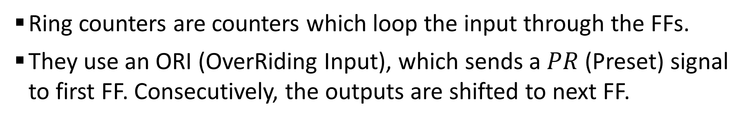
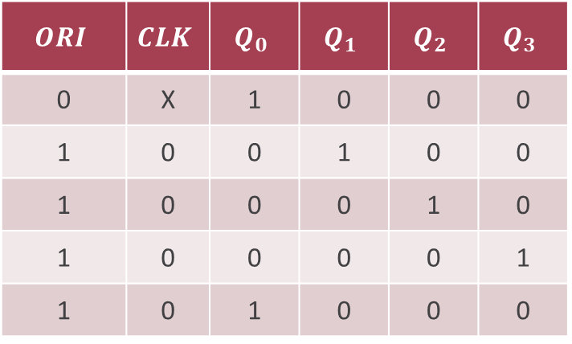
Sample 2
Ring Counters
Ring counters are counters which loop the input through the FFs.
They use an ORI (OverRiding Input), which sends a $PR$ (Preset) signal to first FF. Consecutively, the outputs are shifted to next FF.
$$ORI$$ | $$CLK$$ | $$Q_{0}$$ | $$Q_{1}$$ | $$Q_{2}$$ | $$Q_{3}$$
0 | X | 1 | 0 | 0 | 0
1 | 0 | 0 | 1 | 0 | 0
1 | 0 | 0 | 0 | 1 | 0
1 | 0 | 0 | 0 | 0 | 1
1 | 0 | 1 | 0 | 0 | 0

Slide 11
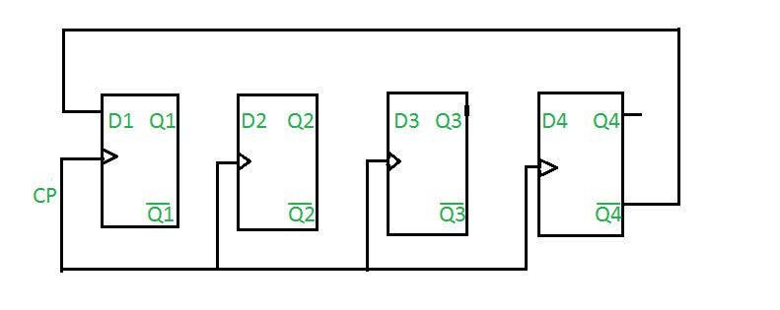
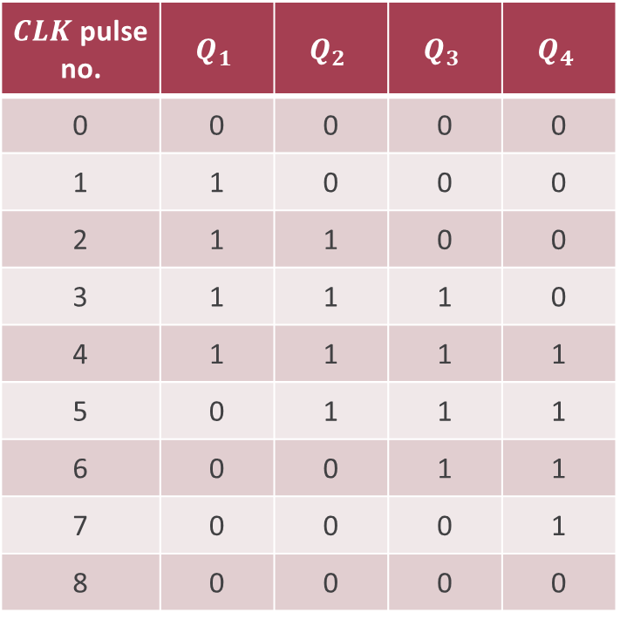
Sample 2
Johnson Counters
Also known as Creeping counters, the complemented output from last FF is connected to the first FF.
It is simply a Ring counter with inversion.
$CLK$ pulse no. | $$Q_{1}$$ | $$Q_{2}$$ | $$Q_{3}$$ | $$Q_{4}$$
0 | 0 | 0 | 0 | 0
1 | 1 | 0 | 0 | 0
2 | 1 | 1 | 0 | 0
3 | 1 | 1 | 1 | 0
4 | 1 | 1 | 1 | 1
5 | 0 | 1 | 1 | 1
6 | 0 | 0 | 1 | 1
7 | 0 | 0 | 0 | 1
8 | 0 | 0 | 0 | 0

Slide 12



THANK YOU
Owais Hussain
+92 345-3174270
owais.hussain@kiet.edu.pk
https://www.researchgate.net/profile/Owais-Hussain-3

